Slide 1

Weekly Report

Slide 2
Progress 13 Januari – 2 Feb 2021
Melanjutkan coding bagian aplikasi
Instagram
Investor & CV
Website
Packaging

Slide 3
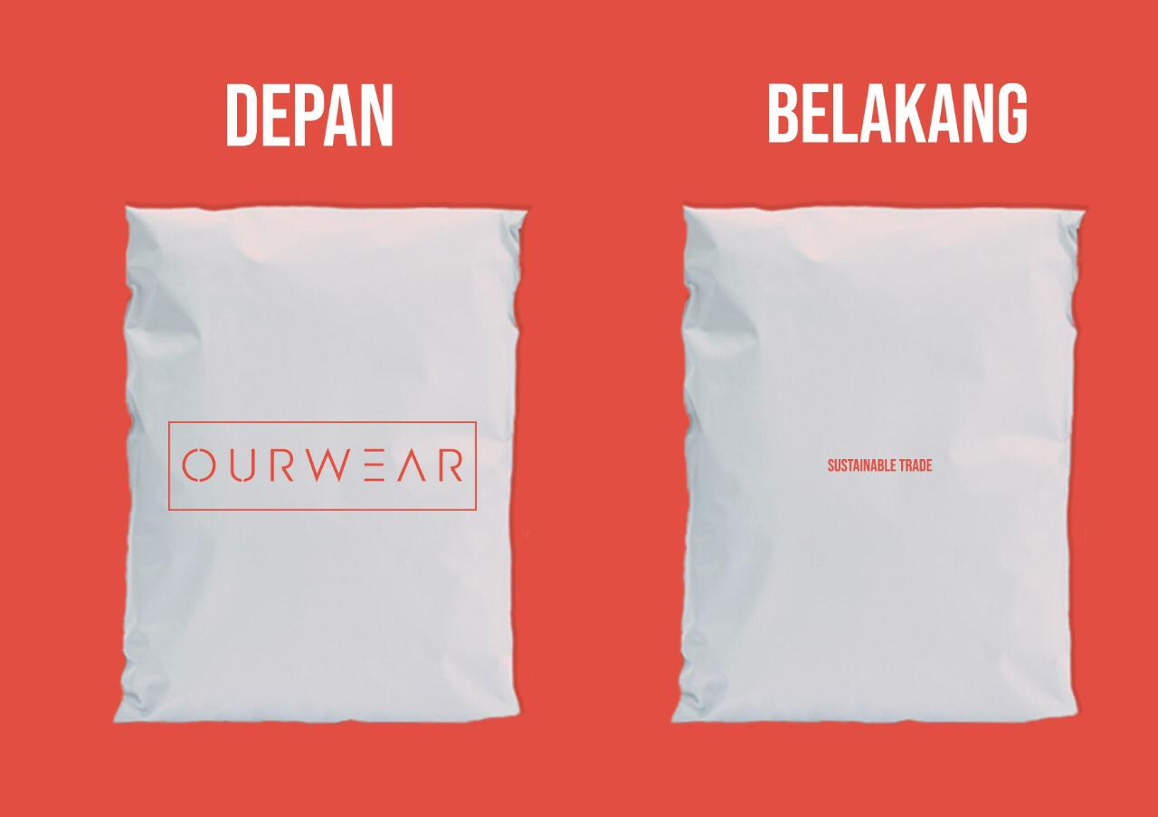


Packaging design
Desain packaging baru

Slide 4
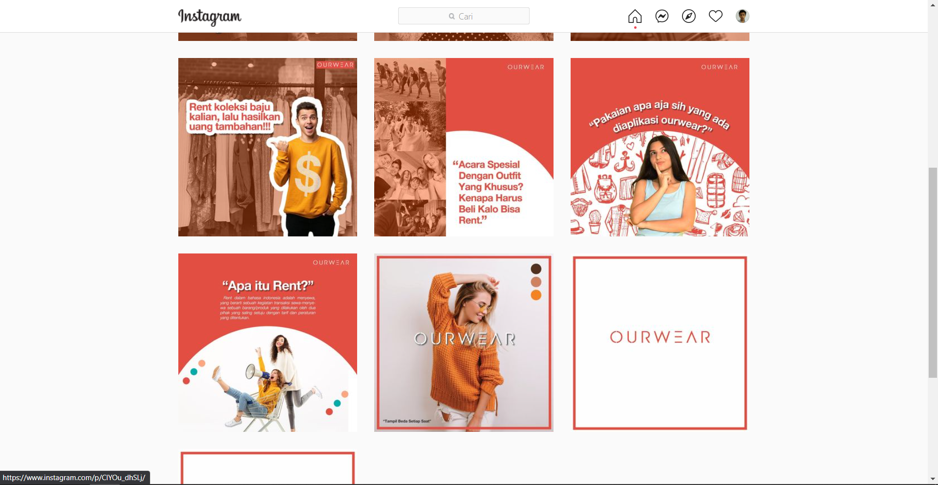
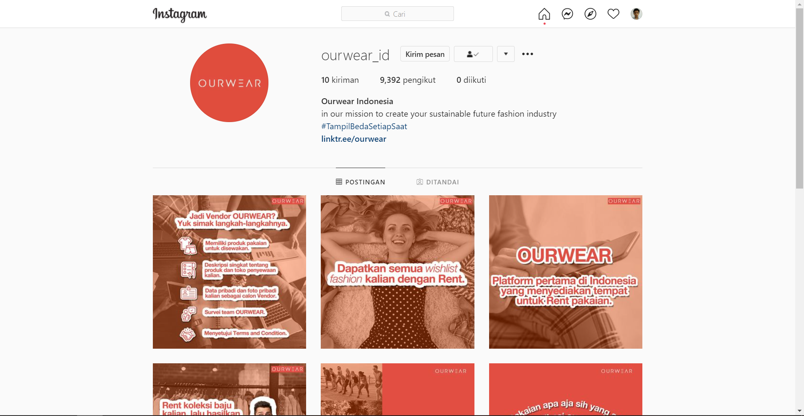
Instagram new post
New instagram post
https://www.instagram.com/ourwear_id/

Slide 5
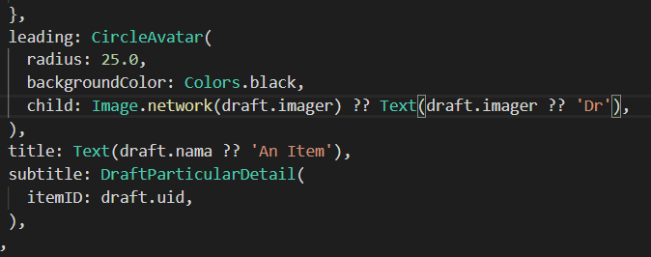
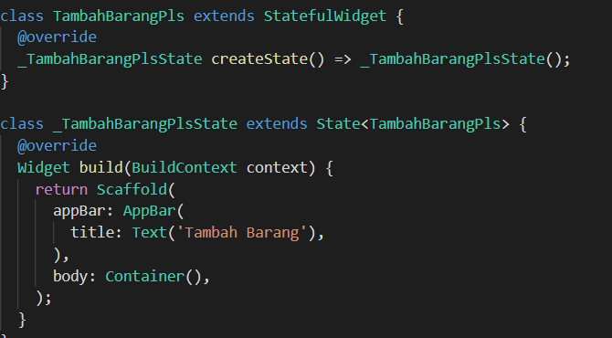
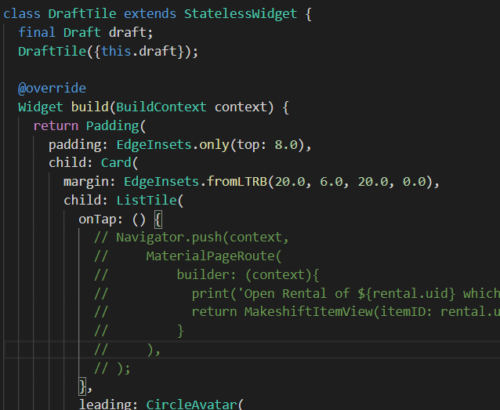
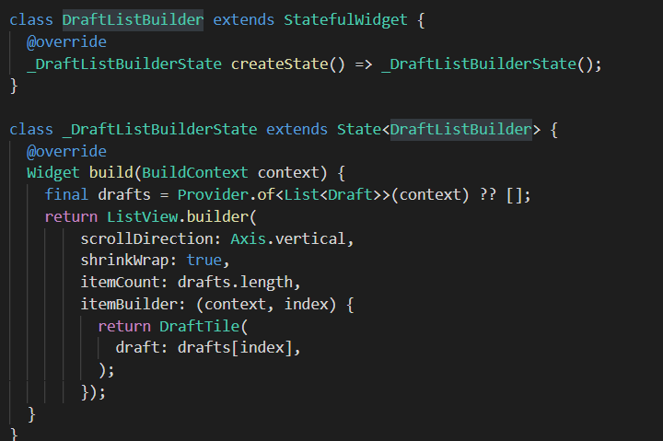
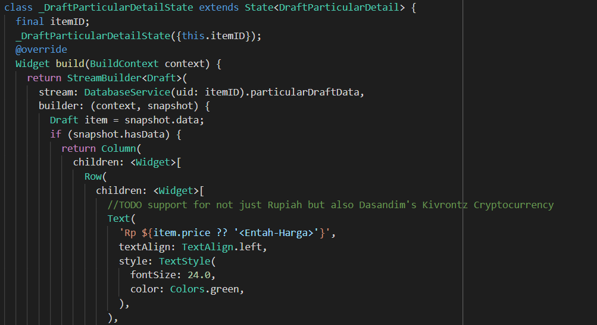
App
Draft add item
Draft list of items in draft
Draft item tile & detail

Slide 6
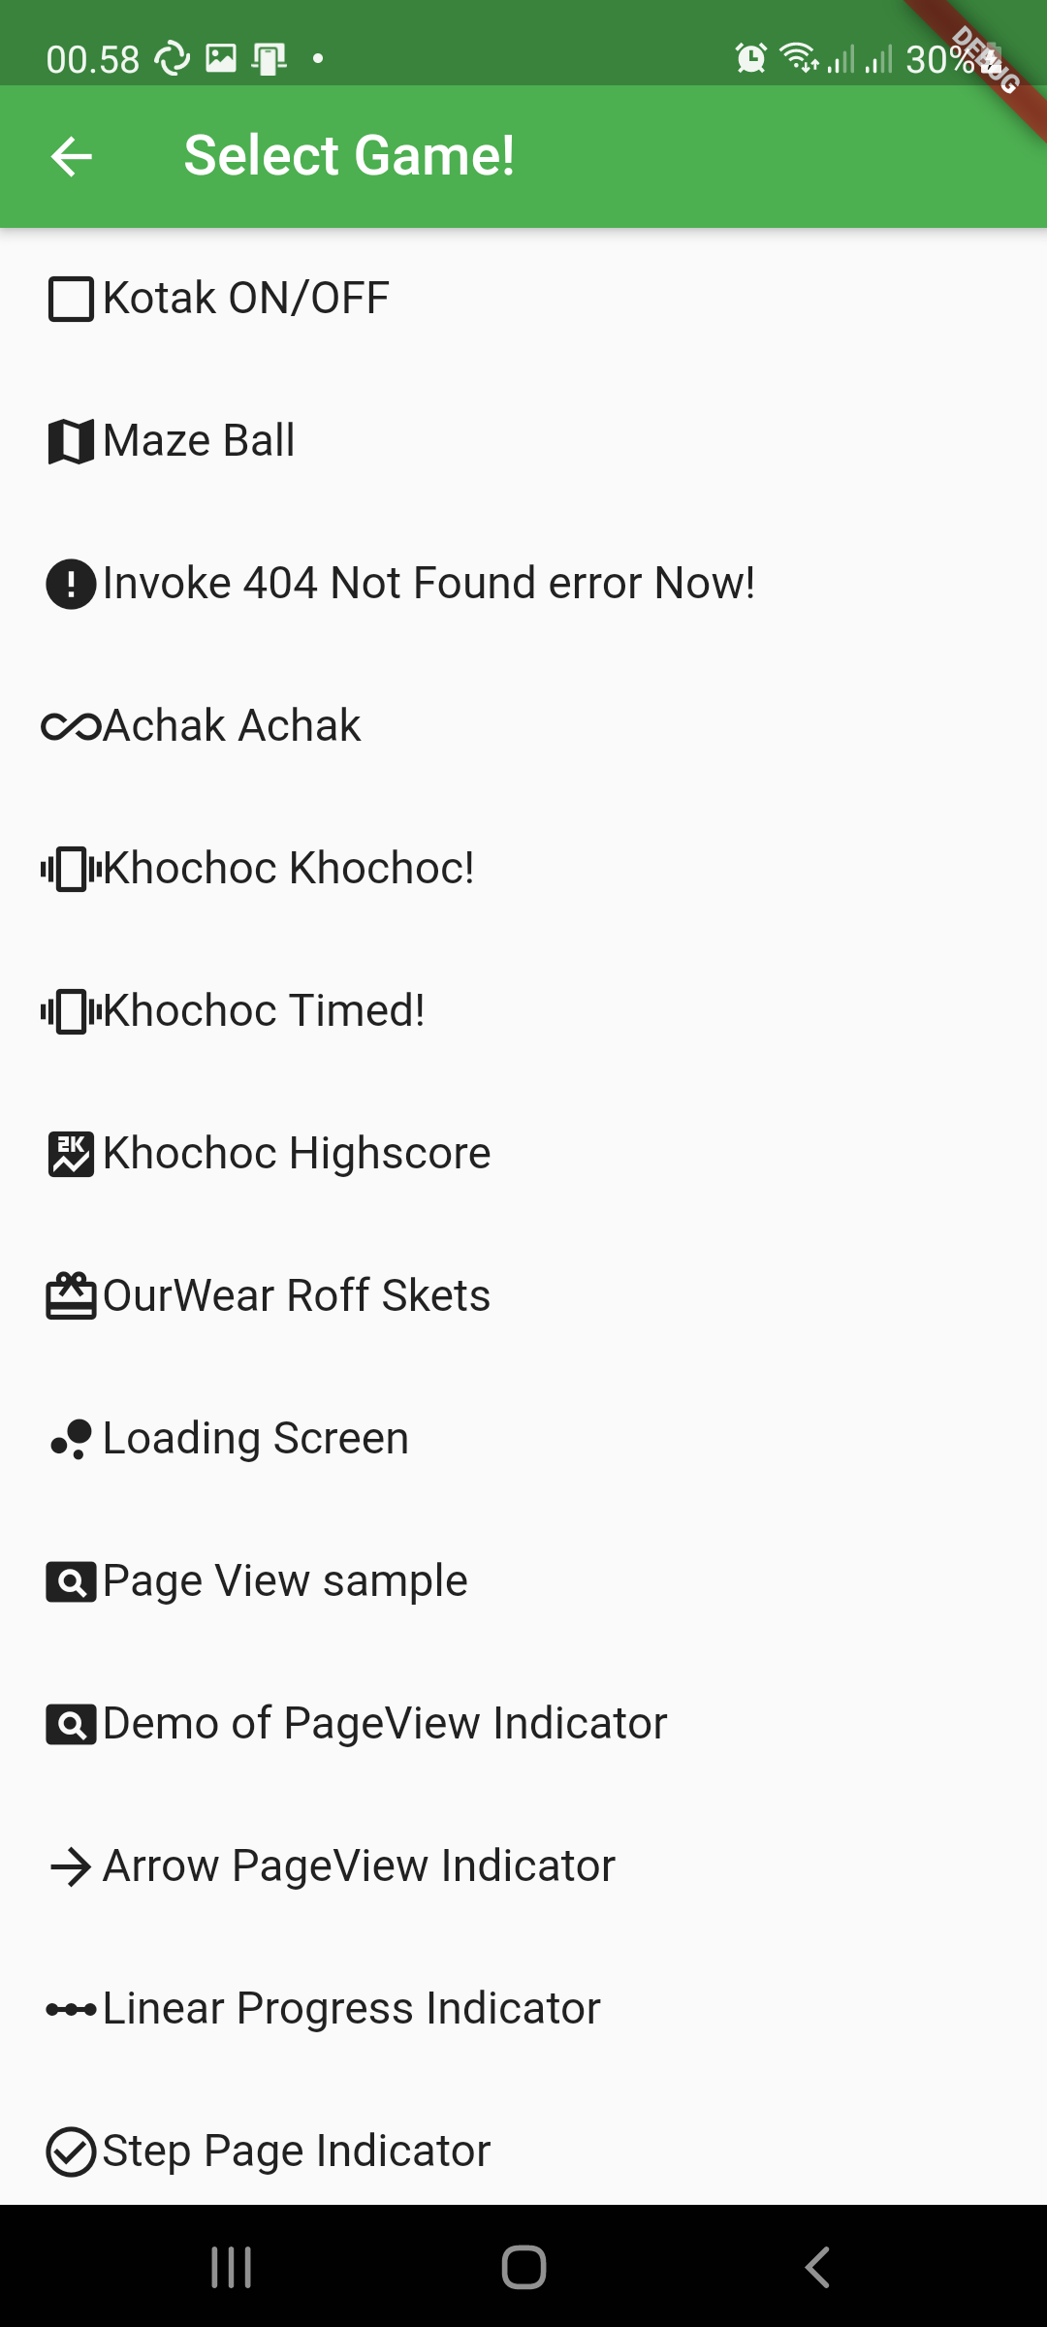
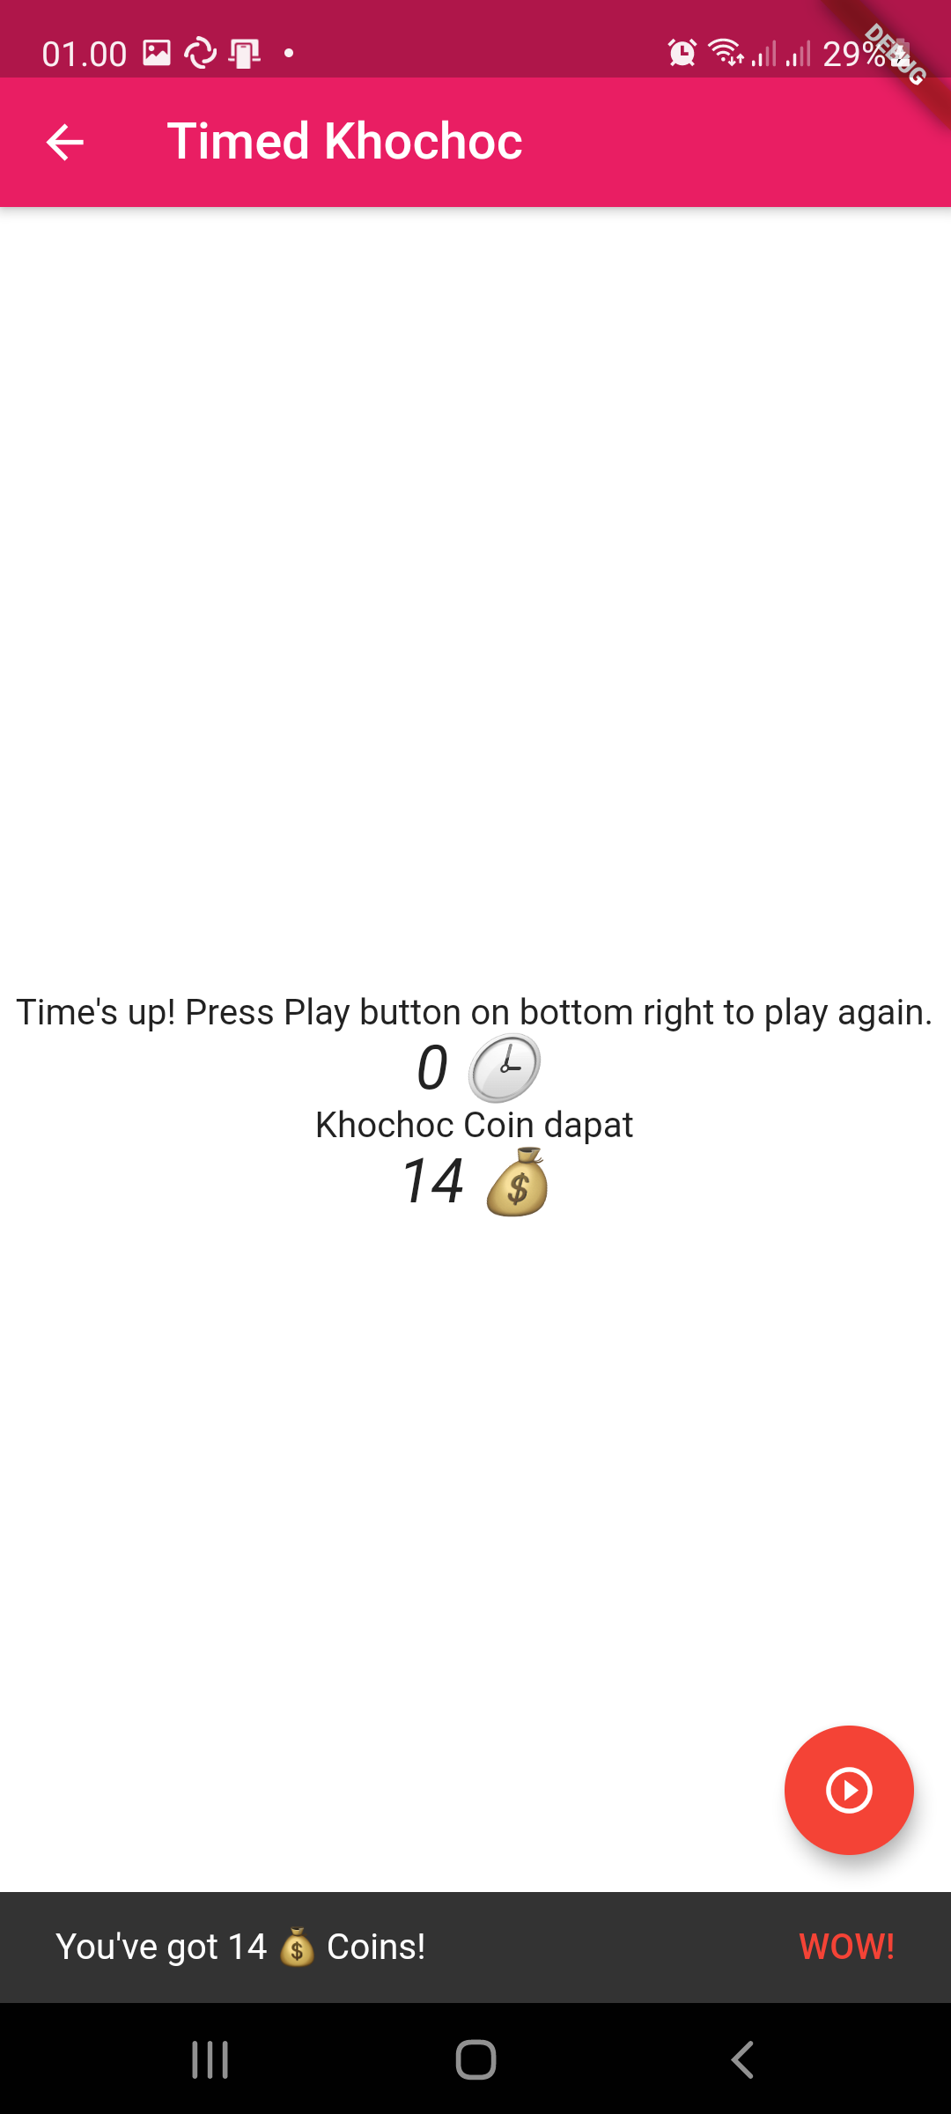
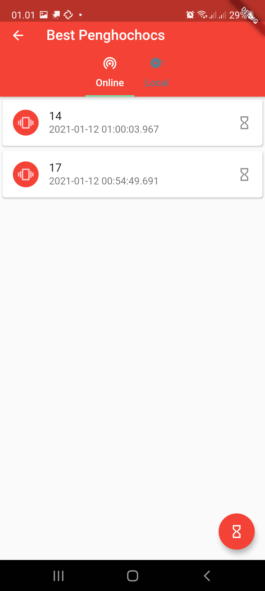
App
Pilihan minigame
Khochoc
Highscore

Slide 7
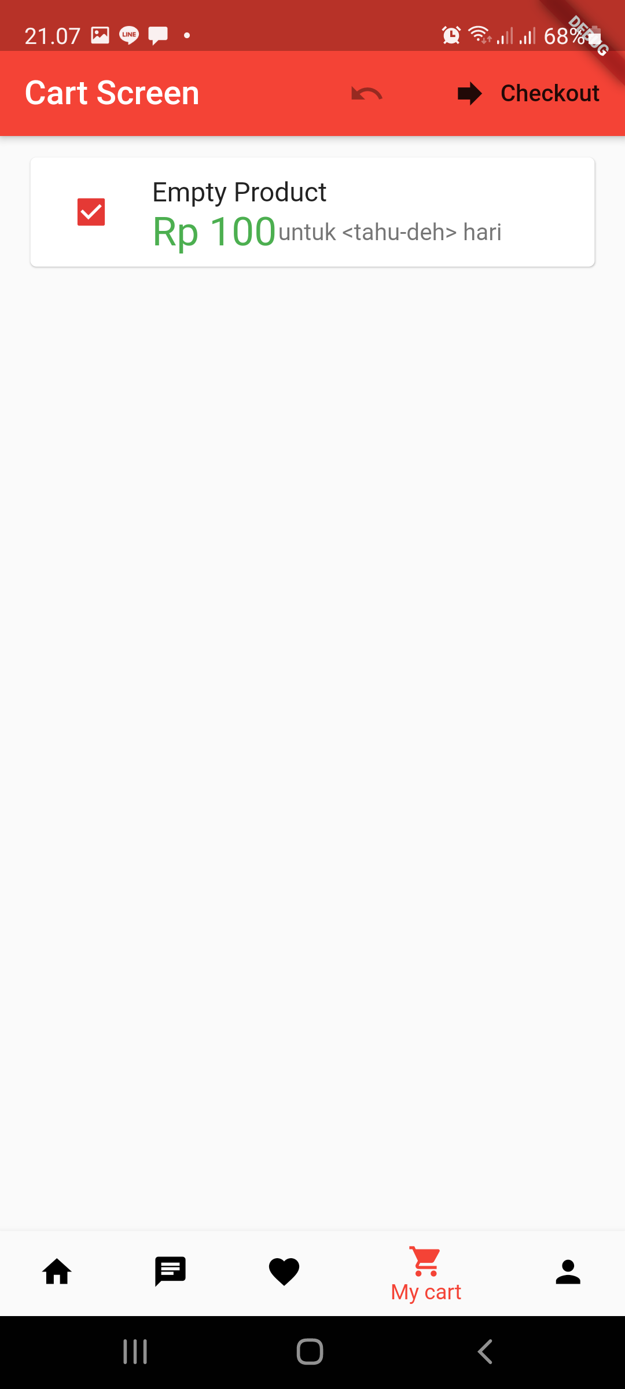
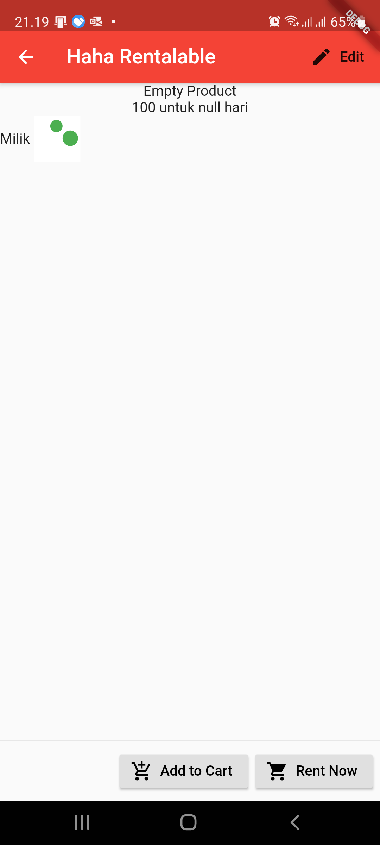
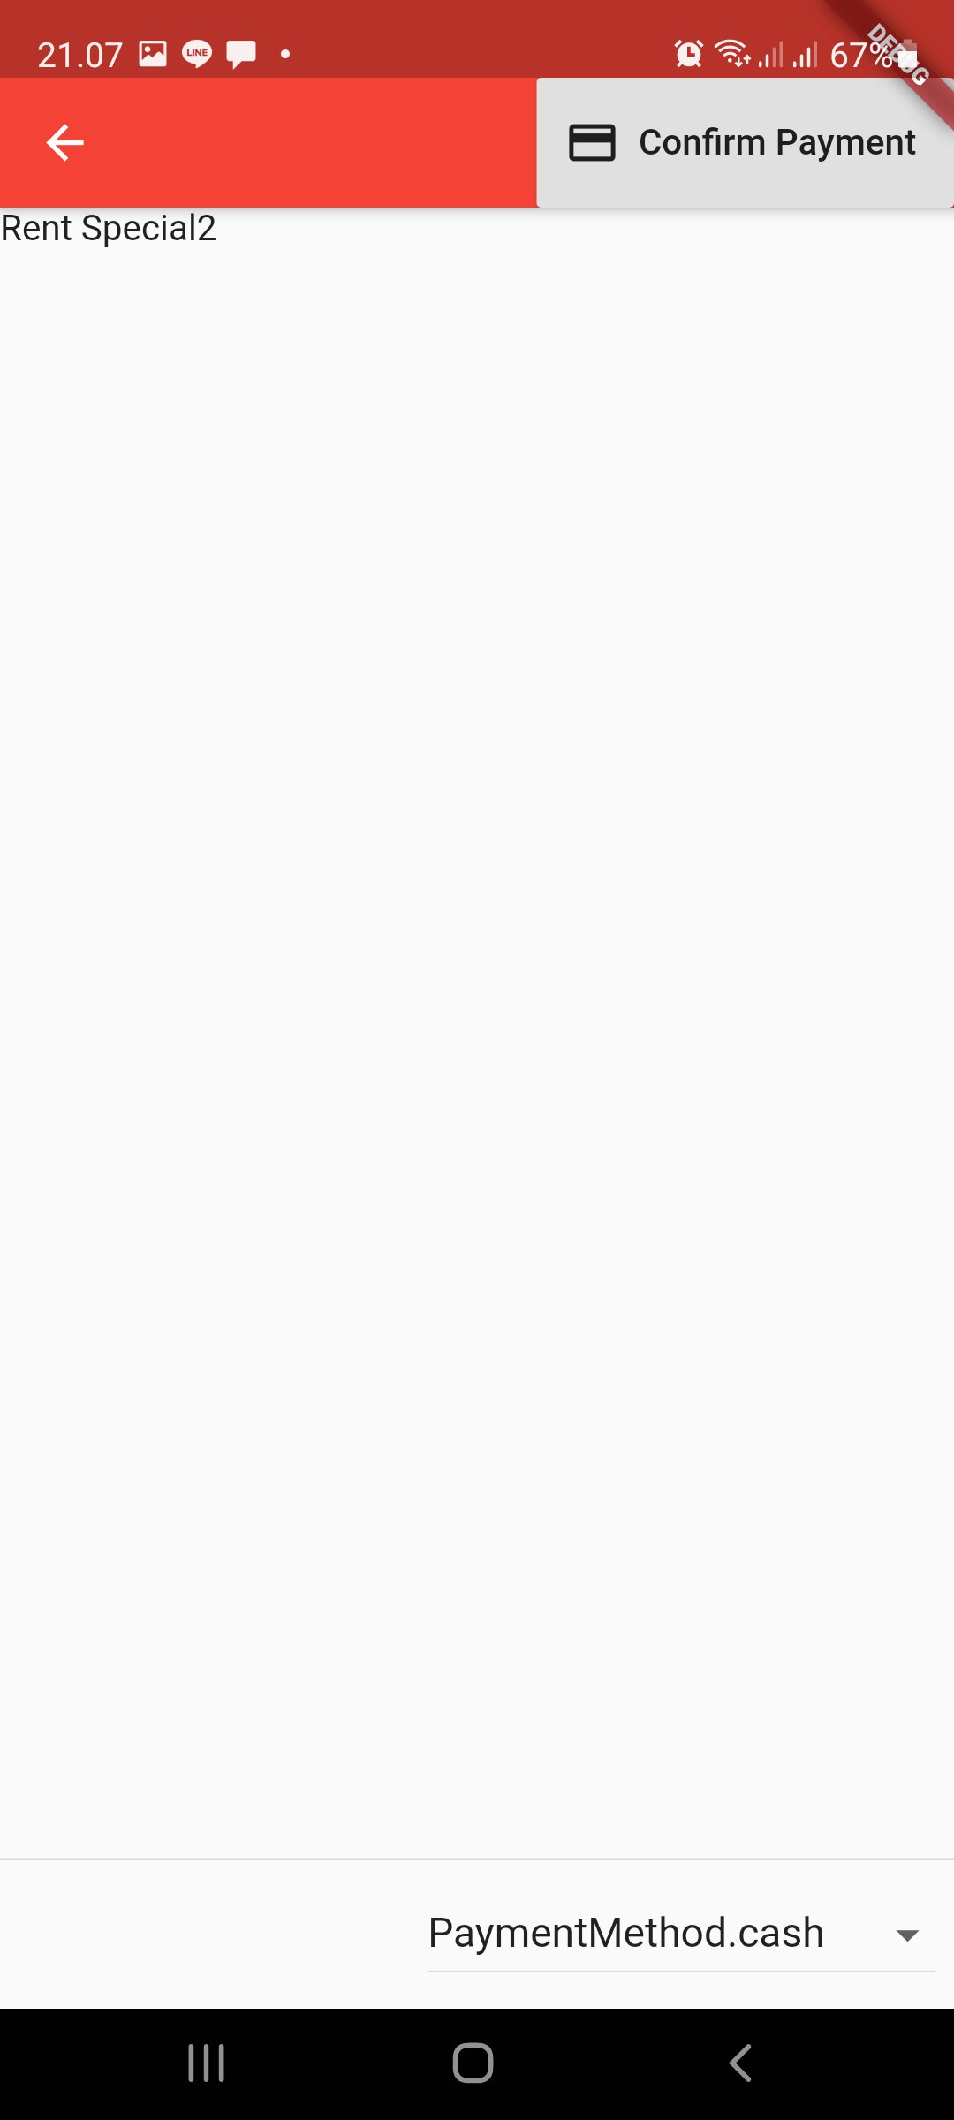
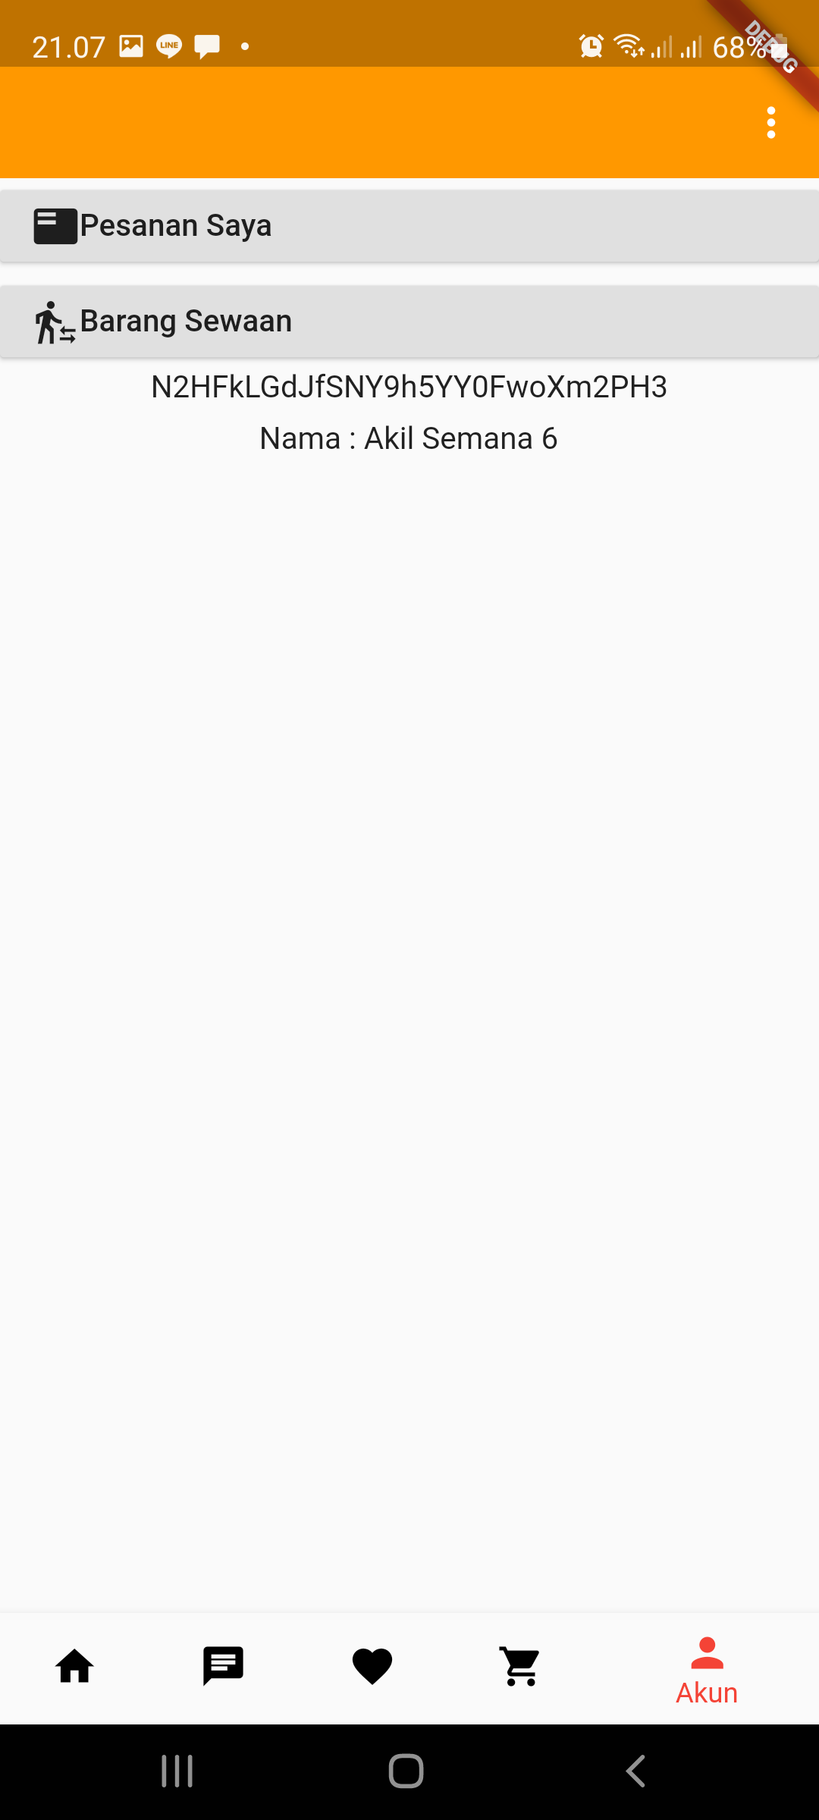
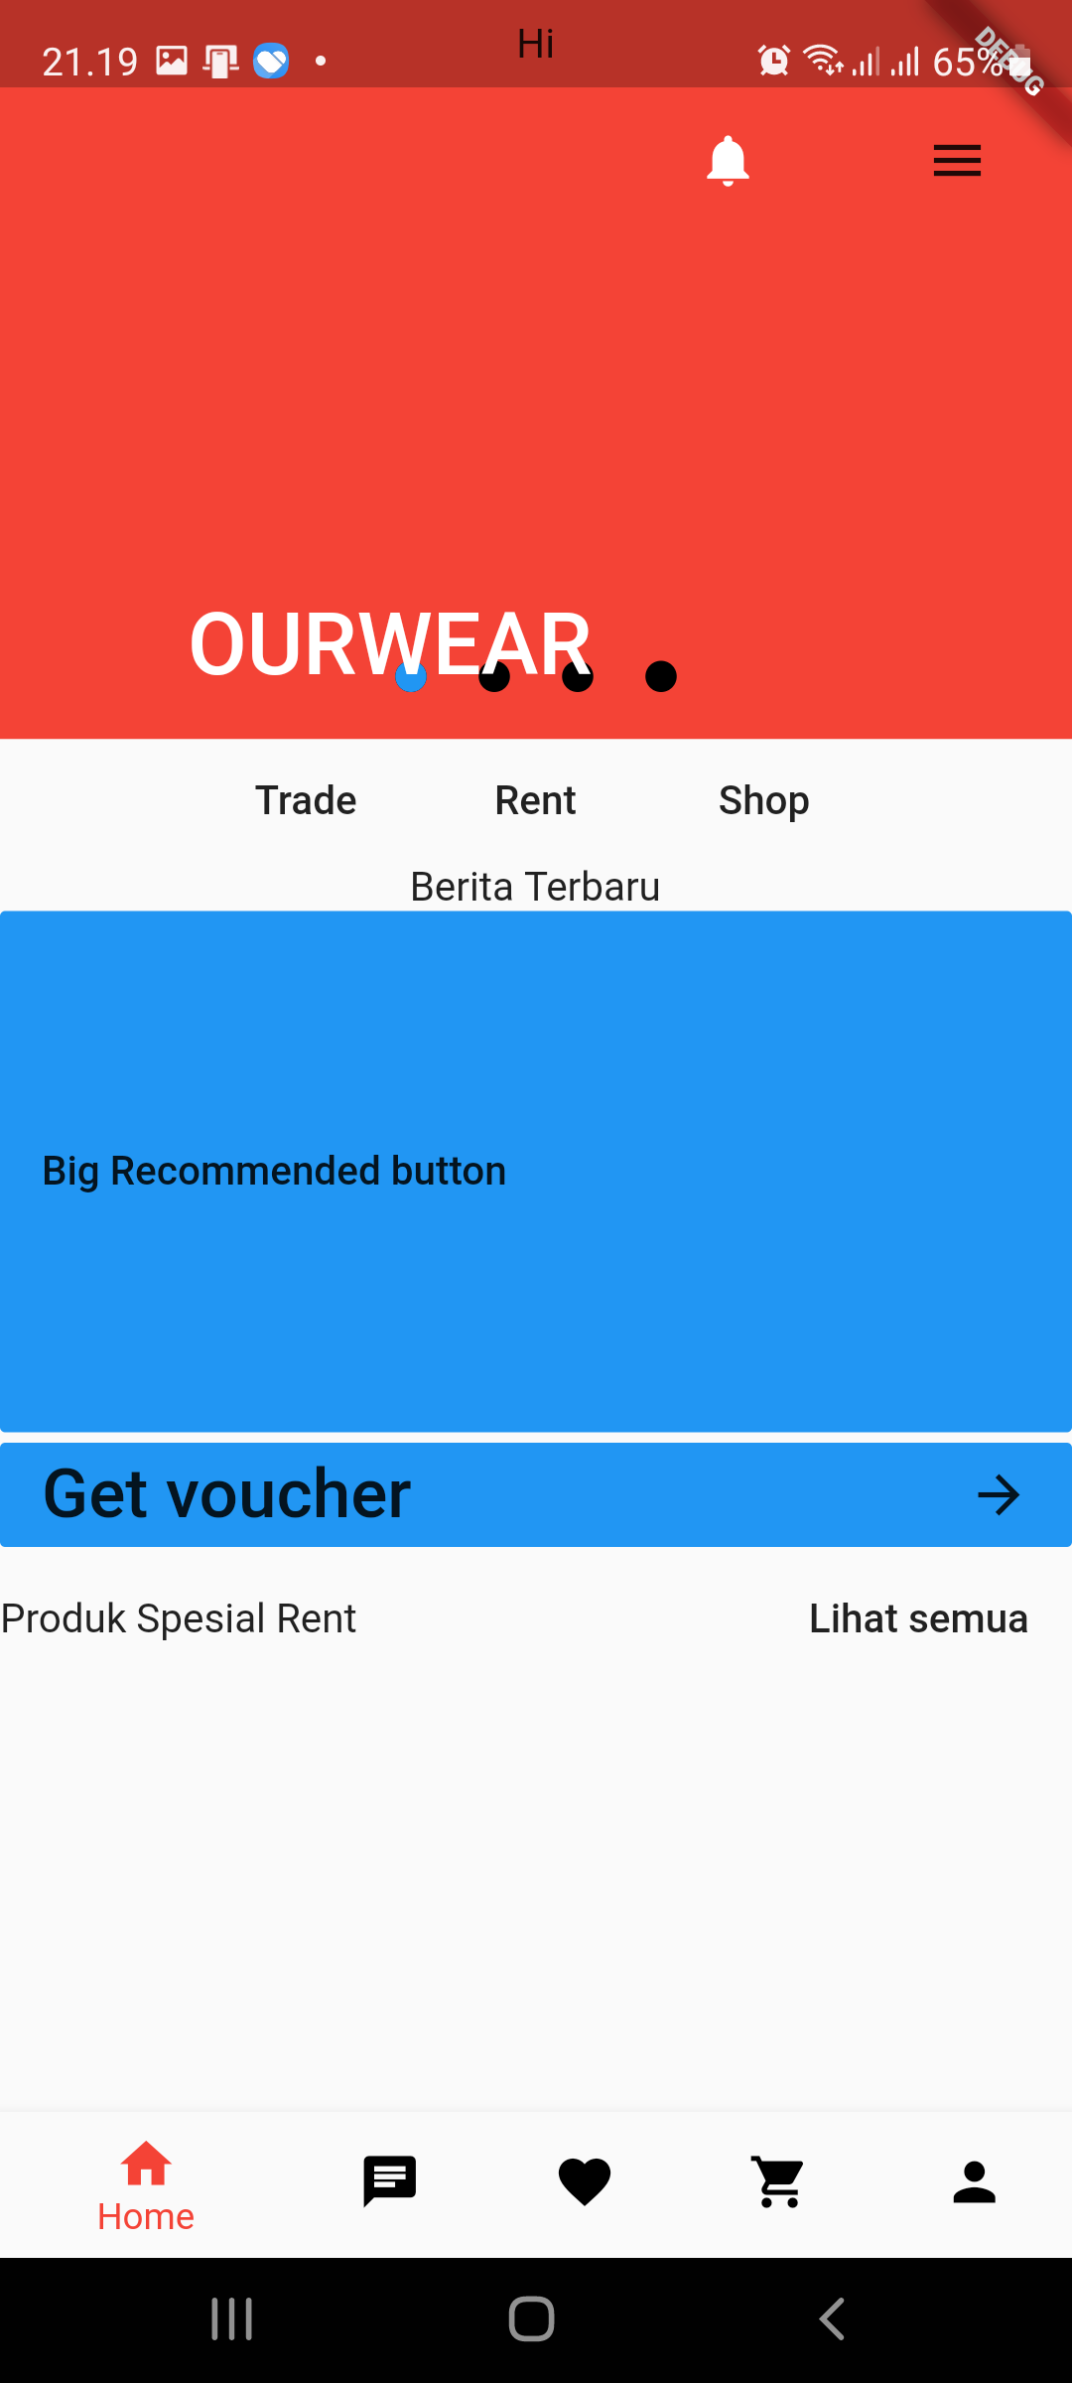
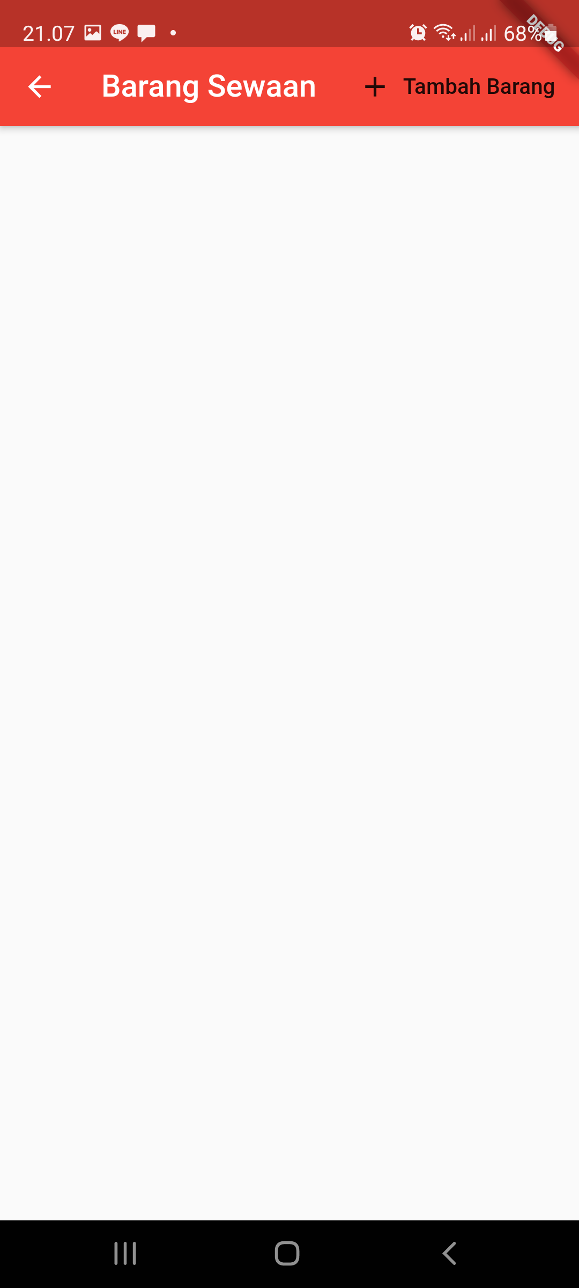
App
Beberapa Screenshot aplikasi

Slide 8
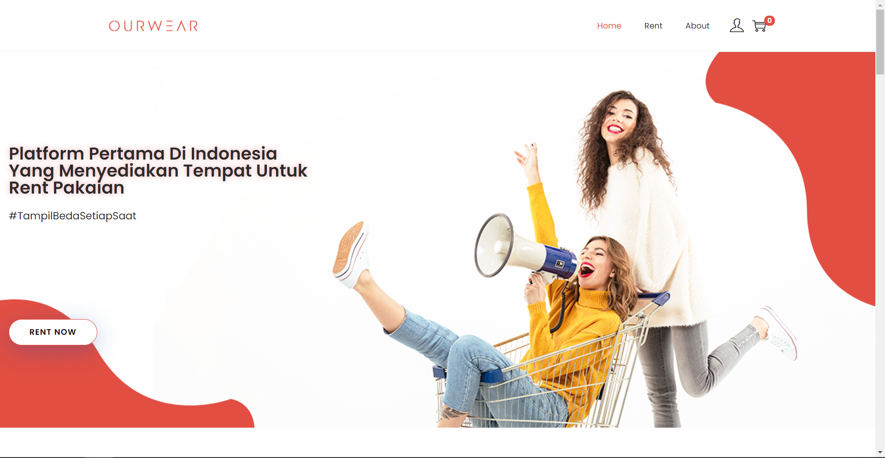
Website
https://ourwear.id
Website baru

Slide 9
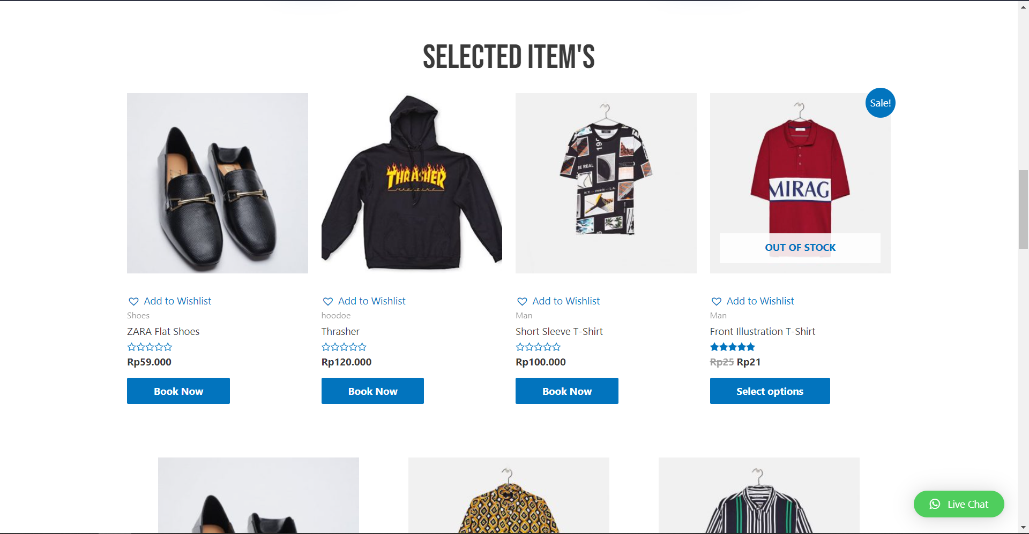
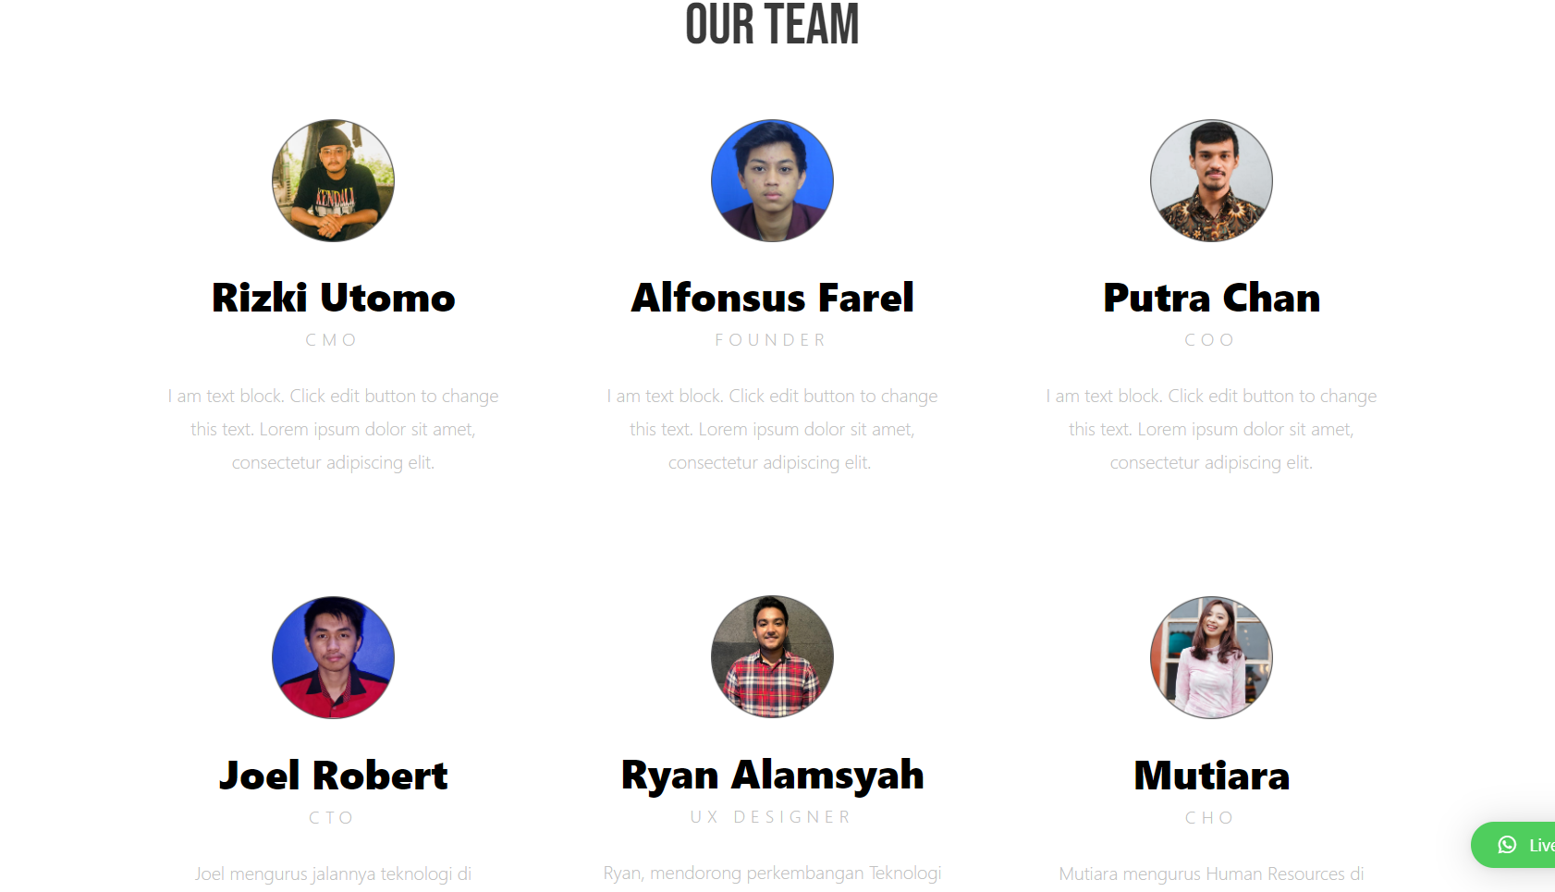
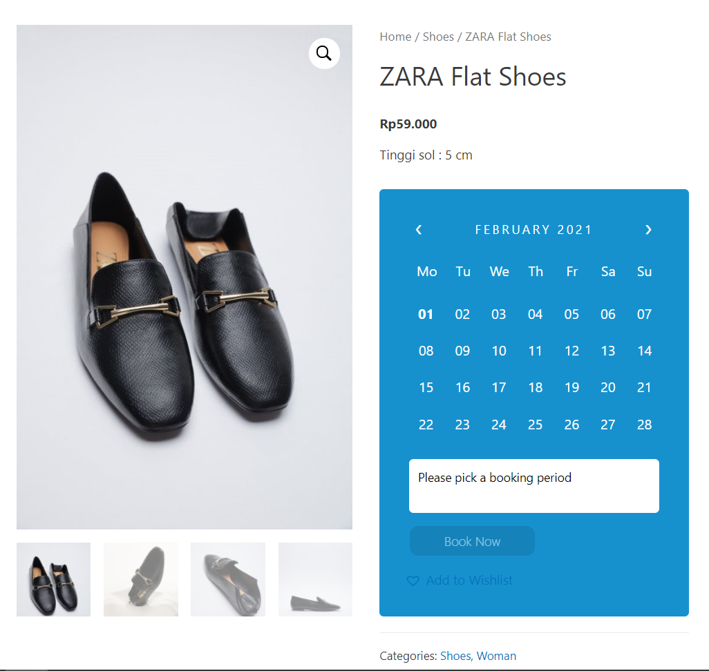
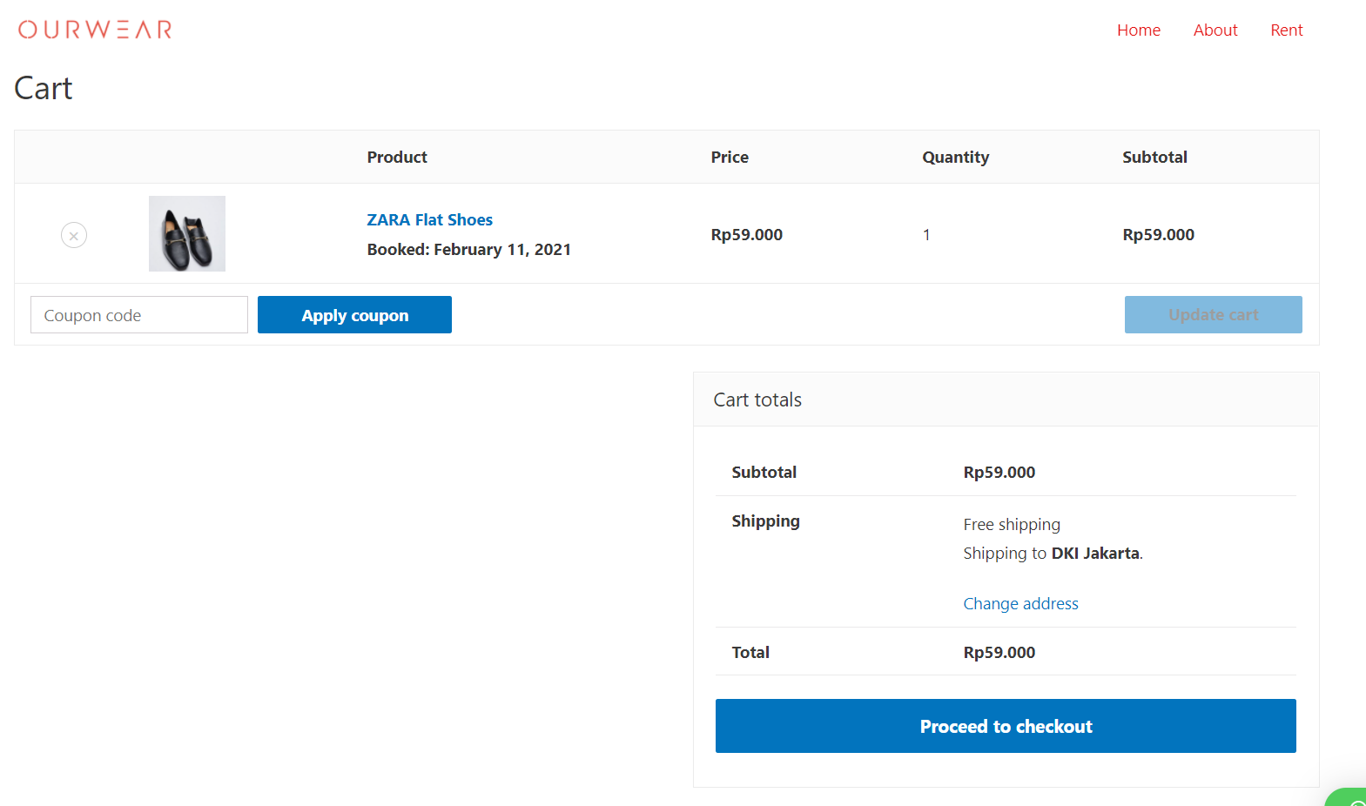
Website
Fungsionalitas website
Booking rental
Cart
About

Slide 10
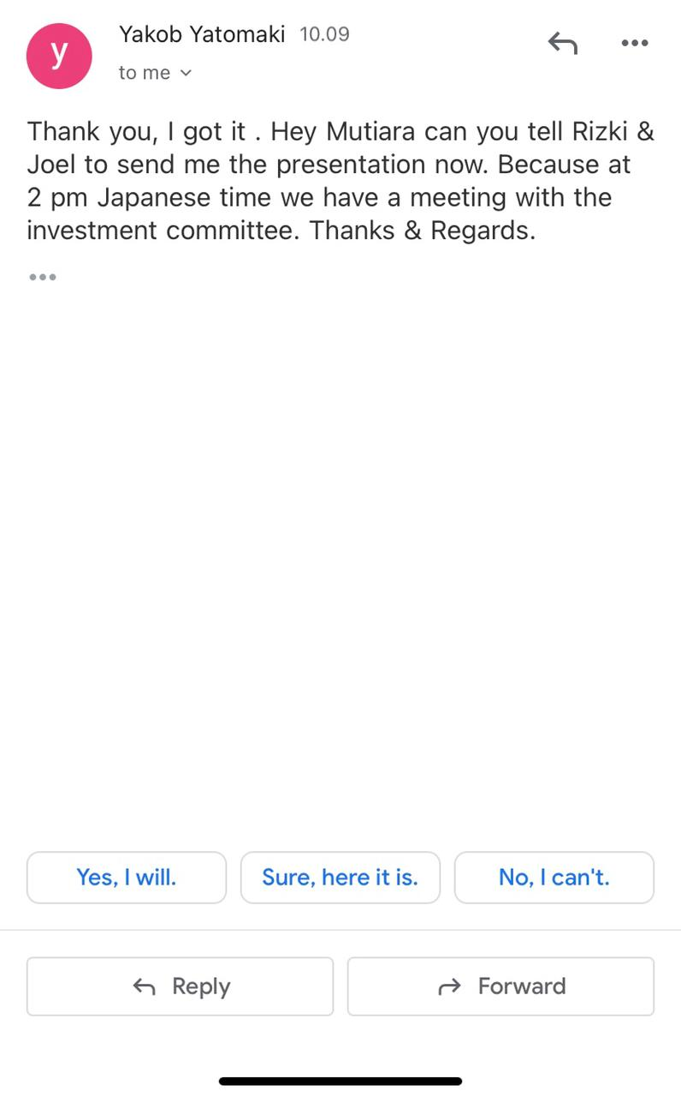
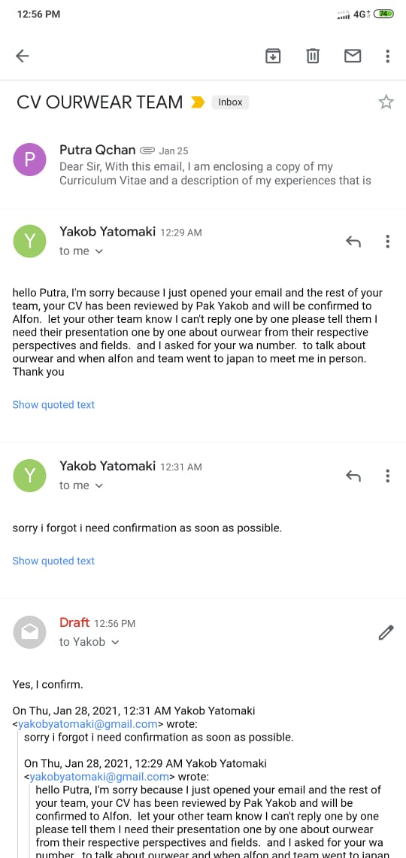
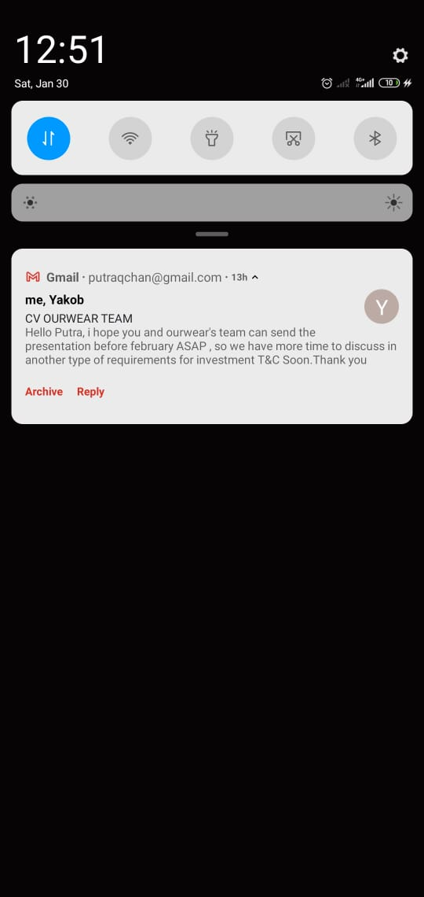
CV
Establish Ourwear sebagai CV. Ourwear
Presentasi untuk investor

Slide 11
Hal lain (dari berbagai ruang diskusi)
Pembahasan chip
[5:16 PM]- Pembahasan endorsment
[5:18 PM]- Pembahasan Target 2021
[5:18 PM]- Instagram Adsense
[5:19 PM]- Ketemu vendor yang udh punya nama
[5:20 PM]- 2021 company profile
xd : - cara orang tau barang match
[5:43 PM]- cara tambah uang di trade
[5:43 PM]- match quick trade
[5:43 PM]- match trade biasa
https://www.niagahoster.co.id/blog/marketing-tools/
https://www.youtube.com/watch?v=H8sef06FRhs
https://www.prettylittlething.us/the-edit/ambassadors
https://www.prettylittlething.com/about
https://www.tokopedia.com/gmicsshop/cover-baju-jas-gaun-peva-anti-air-pelindung-baju-jas-gaun-anti-debu-120-x-60?src=topads

Slide 12
Doing Trello
Syarat Ketentuan
About Us
Kebijakan Privasi
Quick trade
XD akun
App dev
Feed instagram

Slide 13
To do Trello
Payment
Packaging
Proses Bisnis langganan
Quick rent
Copywriting
Vendor clothing & Laundry
Chip & Scanner tracking
XD penarikan saldo
XD tukar tambah uang dalam trade

